Slide 1

SAFETY FIRST
Members and staff are working together to keep our Clubhouse community safe amidst the possible spread of COVID-19 and other viruses.

Slide 2
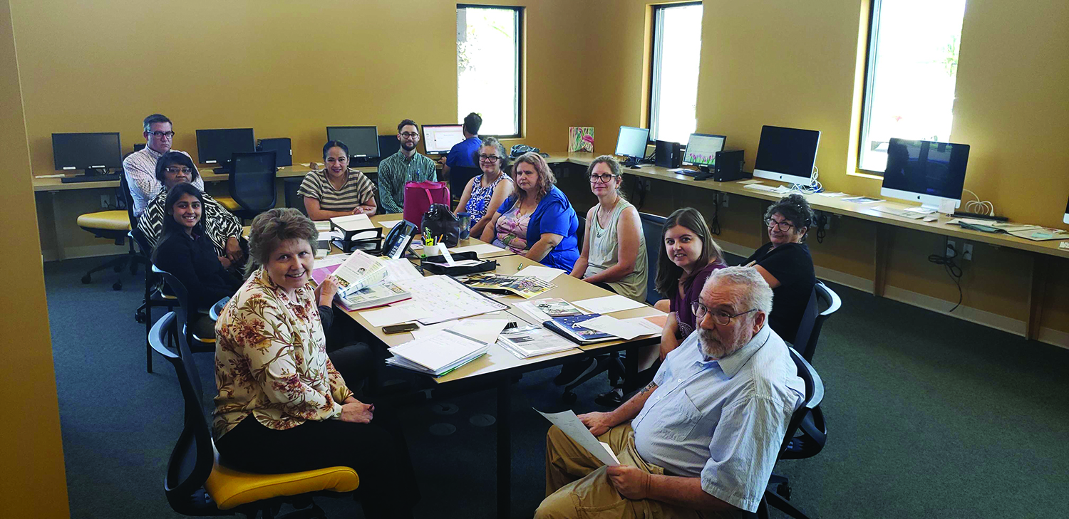
WE CARE
The special nature of our Clubhouse community means that we care deeply about the wellbeing of all members, staff and volunteers. We will come together to support each other and meet current challenges.

Slide 3
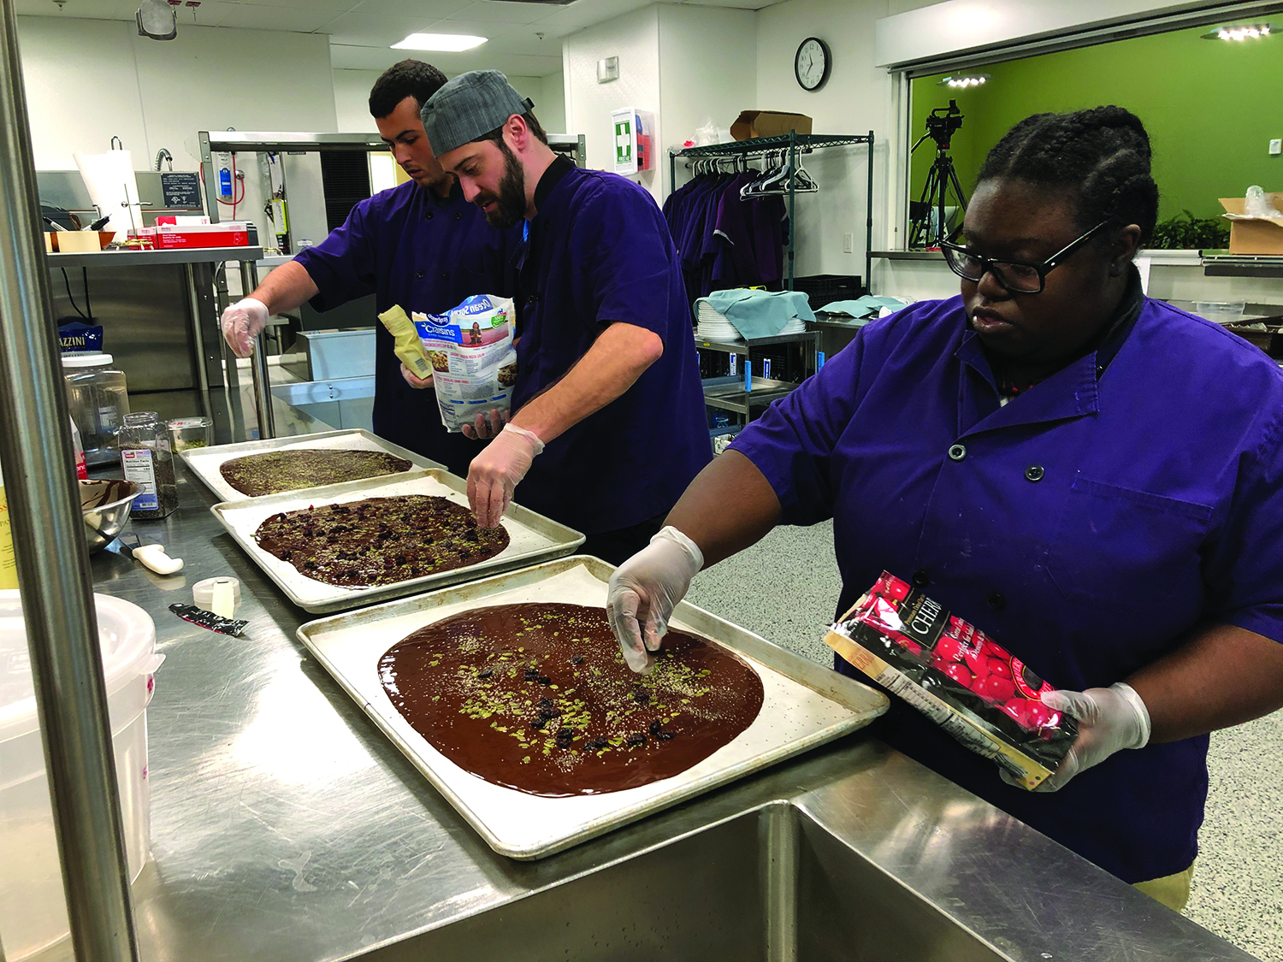
SAFETY IS OUR HIGHEST PRIORITY
Our Goal: Keep everyone healthy without limiting the recovery process of our members or the effectiveness of Clubhouse staff.

Slide 4
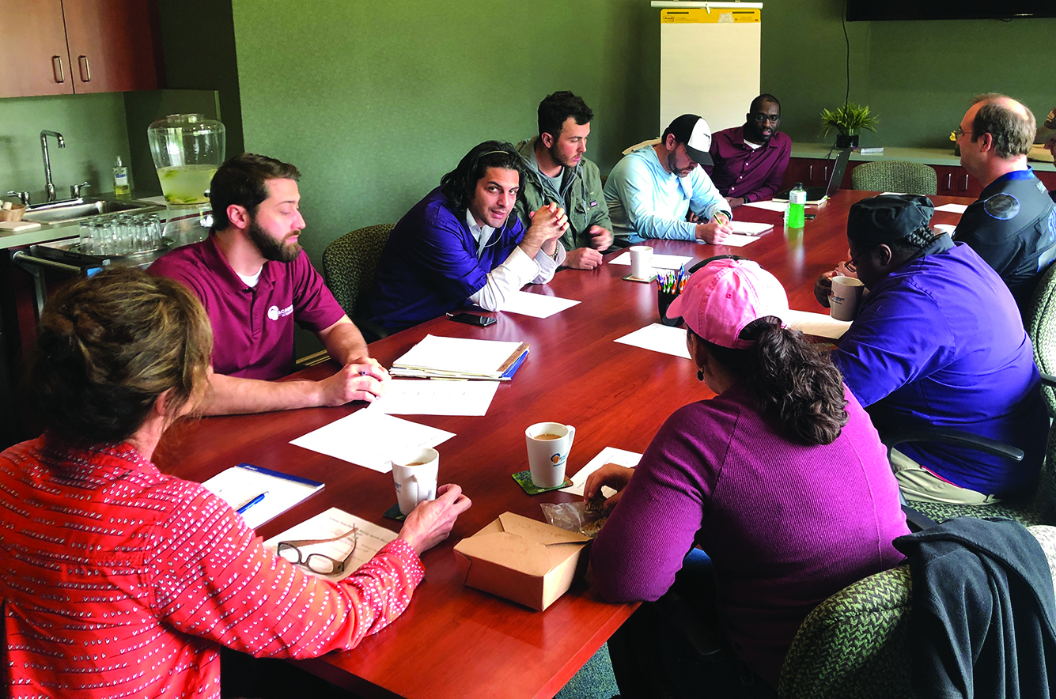
WE REMAIN CALM AND ACTIVE
There is no cause for panic. By taking proper precautions, we can reduce the likelihood of illness while maintaining normal daily activities.
Participation at the Academy continues as usual. Our work-ordered day, Transitional and Supported Employment, evening and weekend activities continue to be vibrant.
Come in and join us!

Slide 5
KNOWLEDGE IS POWER
Together, we are promoting an ongoing dialogue in our Clubhouse community regarding COVID-19 and other viruses. Information will be shared and discussed at all morning, unit and weekly Academy meetings.
As updates are received from the CDC or local health officials, it will be shared with our community so that precautions (if necessary) can be implemented.

Slide 6
BETTER HABITS TRANSFORM LIVES
By making small changes in our daily habits we can stay safe at home, at the Academy, at work and in the community.
The following slides contain recommendations to avoid the spread of germs.

Slide 7
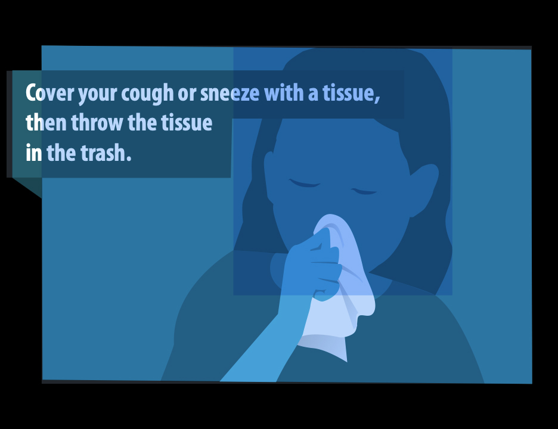
Cover your cough or sneeze with a tissue, then throw the tissue in the trash.
An alternate method would be
to cough or sneeze into your elbow or sleeve.
Be sure to thoroughly wash your
hands after coughing or sneezing.
Image from Center for Disease Control

Slide 8
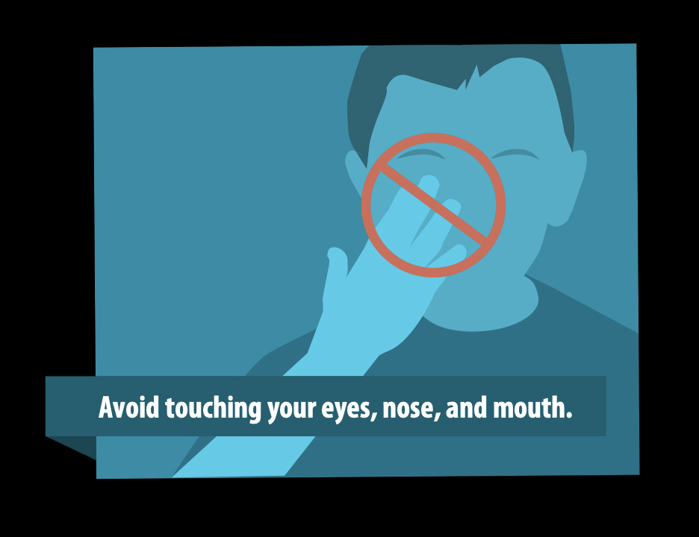
Avoid touching your eyes, nose and mouth.
Your eyes, nose and mouth are the primary entry points for germs.
Wash your hands before and after touching your face will help reduce your risk or becoming ill or spreading it to others.
Image from Center for Disease Control

Slide 9
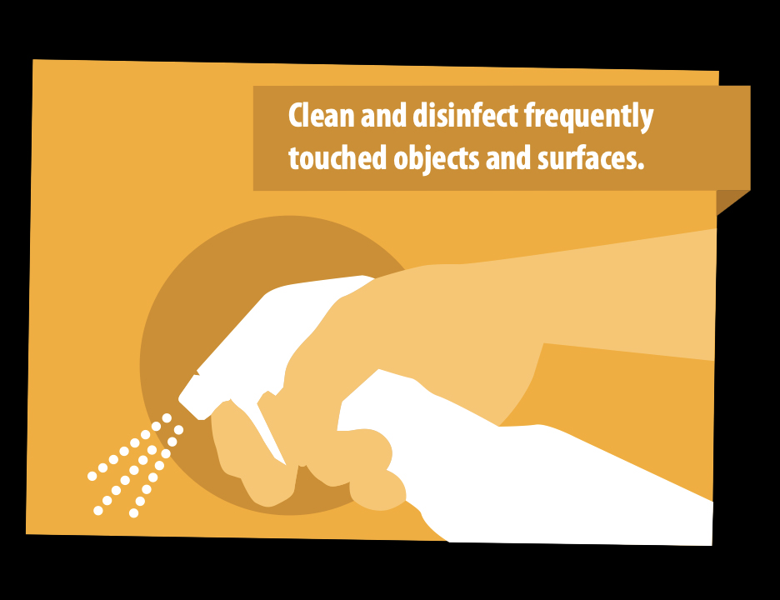
Clean and disinfect frequently touched objects and surfaces
Allowing the disinfected surfaces to air dry is most effective.
Remember to disinfect doorknobs, desks, computer keyboards and mice, telephones
and other high-touch surfaces.
Image from Center for Disease Control

Slide 10
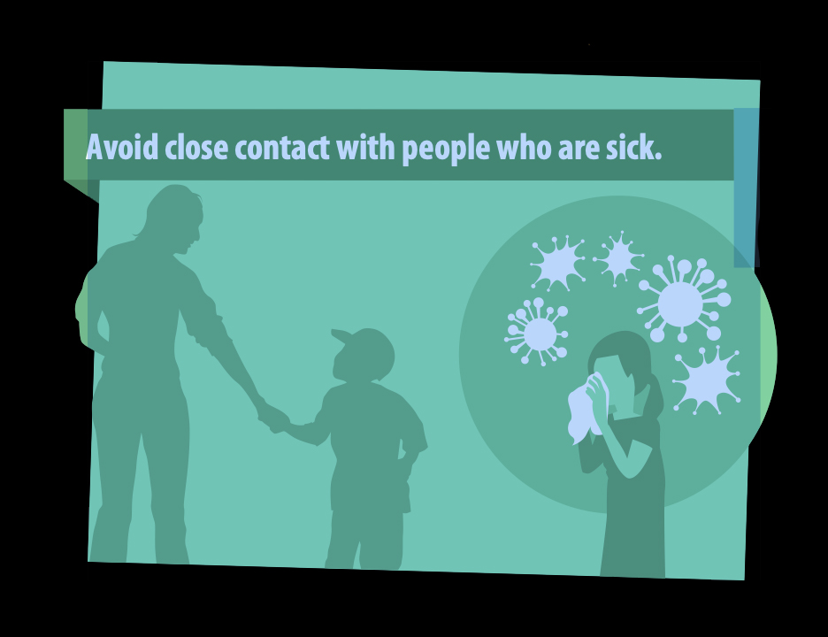
Avoid close contact with people who are sick.
The CDC recommends staying
six feet away from anyone who appears sick.
Instead of shaking hands or hugging, use a foot tap, air
fist-bump or simply say hello.
Image from Center for Disease Control

Slide 11
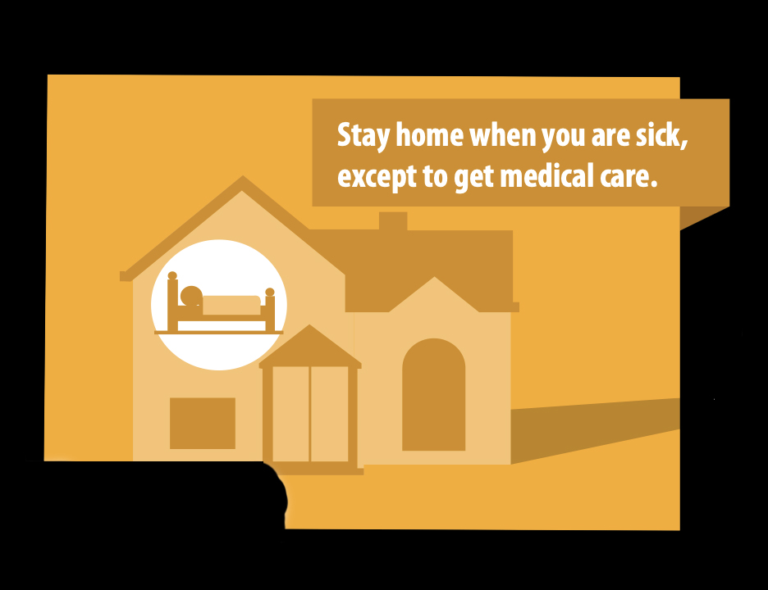
Stay home when you are sick, except to get medical care
If you are feeling sick, stay home.
However, if medical care is needed, contact your doctor first for their advice. They may want you to visit their office or another urgent care facility.
Image from Center for Disease Control

Slide 12
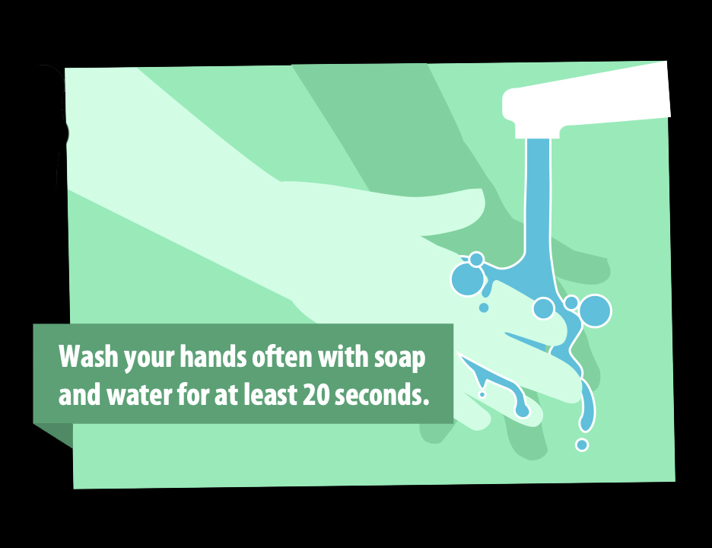
Wash your hands often with soap and water for at least 20 seconds
Wash your hands frequently, especially before and after meals, using the restroom and handling cash.
Wash with soap and water for at least 20 seconds – about the time it takes to sing the ABC song or Happy Birthday.
Be sure to wash your palms, the back of your hands, between the fingers and under fingernails.
Hand sanitizers work well, but after three uses, remember to wash with soap and water.
Image from Center for Disease Control

Slide 13

Eat healthy foods
Eating nutritious food helps boost your immune system.
Ask your doctor about strengthening your immune system with supplements and vitamins.

Slide 14
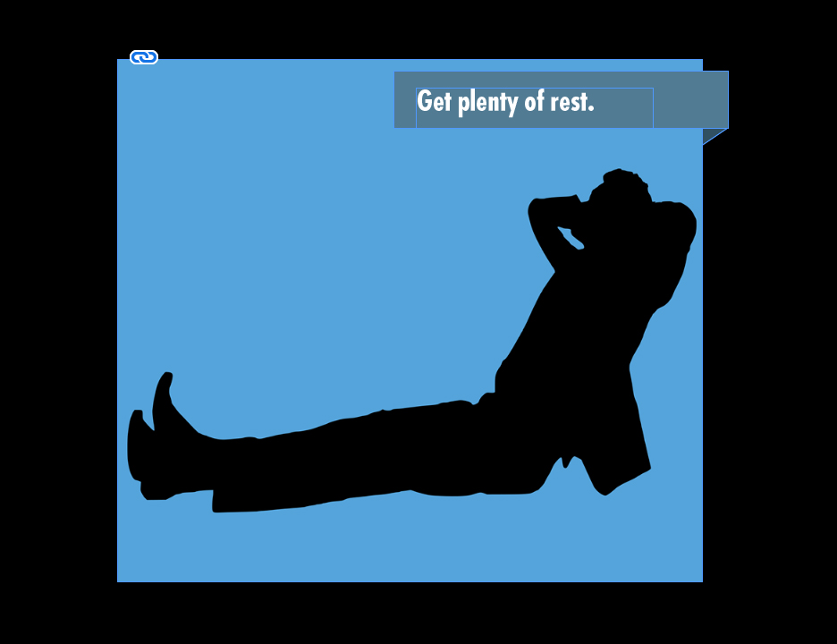
Get plenty of rest and practice self-care
Be sure to get plenty of rest.
Try to reduce or eliminate stress.
Maintain and exercise routine.

Slide 15
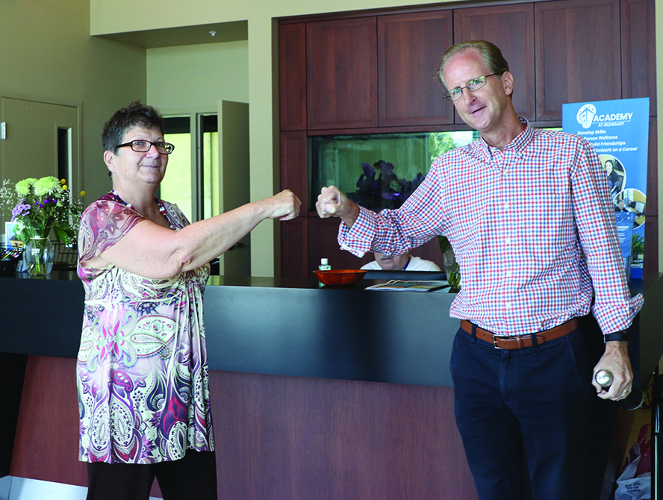
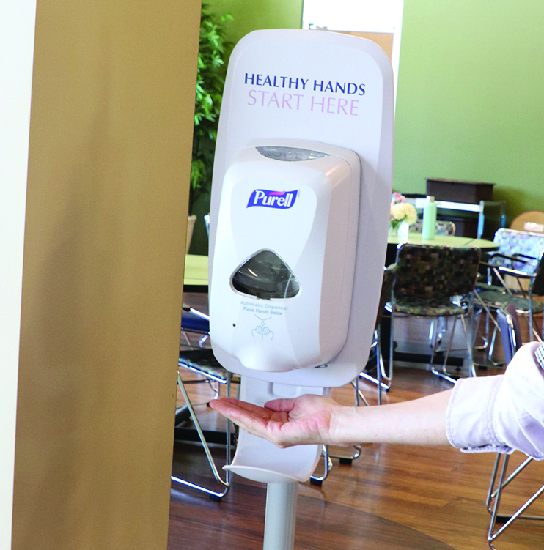
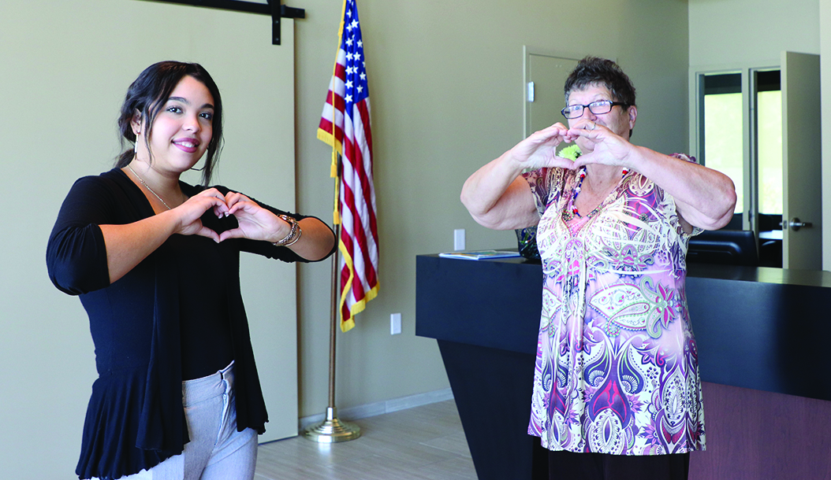
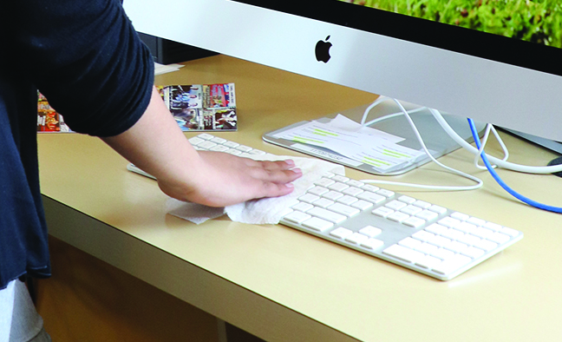
Other steps the Academy is implementing
Our community discusses this topic daily and have developed new practices to implement during this period:
Eliminate hand-shaking and hugging. Using air fist bumps, heart hands or just saying hello.
Provide hand sanitizers and tissues in each area.
Vitamin C lozenges are available around the building.
Frequently disinfect high-contact surfaces such as doorknobs, dining room tables, keyboards and mice and allowing surfaces to air dry.

Slide 16
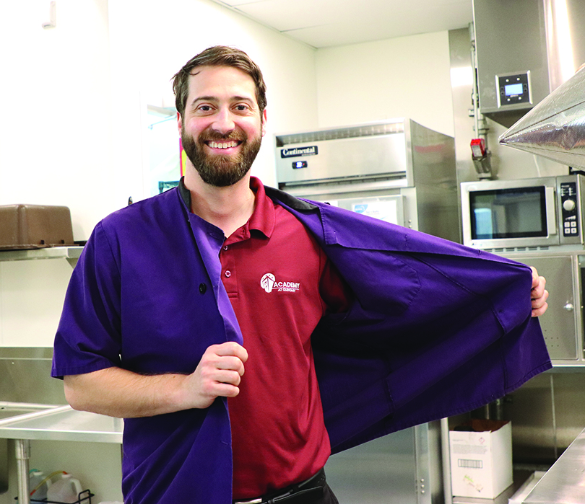
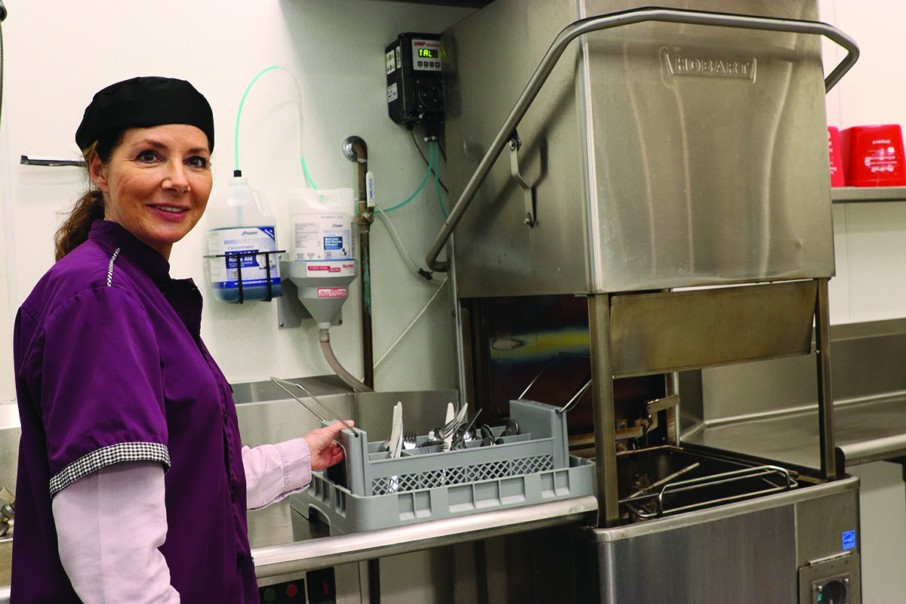
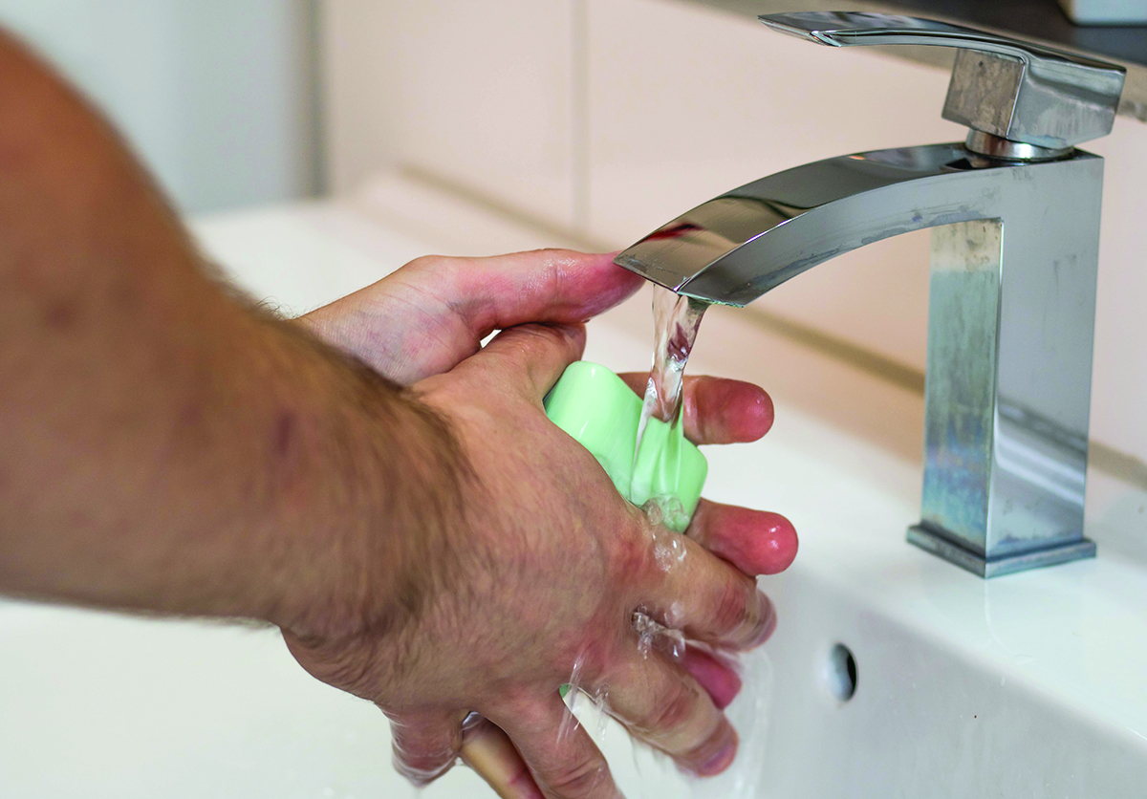
Other steps the Academy is implementing
Remove jackets and gloves when walking away from culinary workstations.
Silverware and drinking glasses are washed and sanitized twice through the dish machine.
Wash hands before and after handling cash.
Practice self-care by getting enough rest, eating nutritious meals and reducing stress.

Slide 17
Symptoms of COVID-19
Cough
Fever
Shortness of Breath
If you think you’ve been exposed to COVID-19:
Stay home and self-isolate from others in the household
Wear a facemask
Avoid contact with pets and other animals
Contact your doctor for advice
Monitor for symptoms

Slide 18
FINAL THOUGHTS
Let's work together to live healthy, vibrant and active lives.
• BE PRO-ACTIVE
• PRACTICE BETTER HABITS
• STAY INFORMED
• STAY CONNECTED
• STAY CALM
We look forward to seeing you at the Clubhouse again soon!

